Slide 1
Fundación Mornés RC Bogota and BBRC Computers for the World Project
May 18th, 2018
Bogotá, Colombia

Slide 2
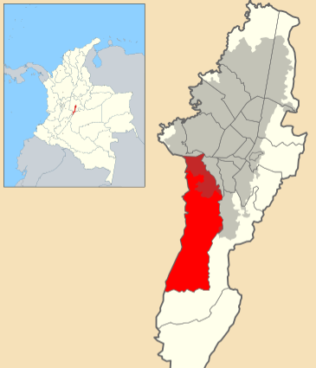
The Environment – Ciudad Bolivar (Bogota)
Its urban portion includes one of the world's largest mega-slums. Concentrates the poorest population in Bogotá and is known for its rampant levels of violence due to a large activity of gangs, mafia, and at times FARC, one of the national terrorist groups of Colombia.
Ciudad Bolivar: Population:
1970: ~50,000
2007: ~600,000
2018: ~2,000,000 (Mostly peasants who were displaced to Bogota due to civil war. Largely kids that are very vulnerable)
Bogota: Population 2018: +8,000,000

Slide 3
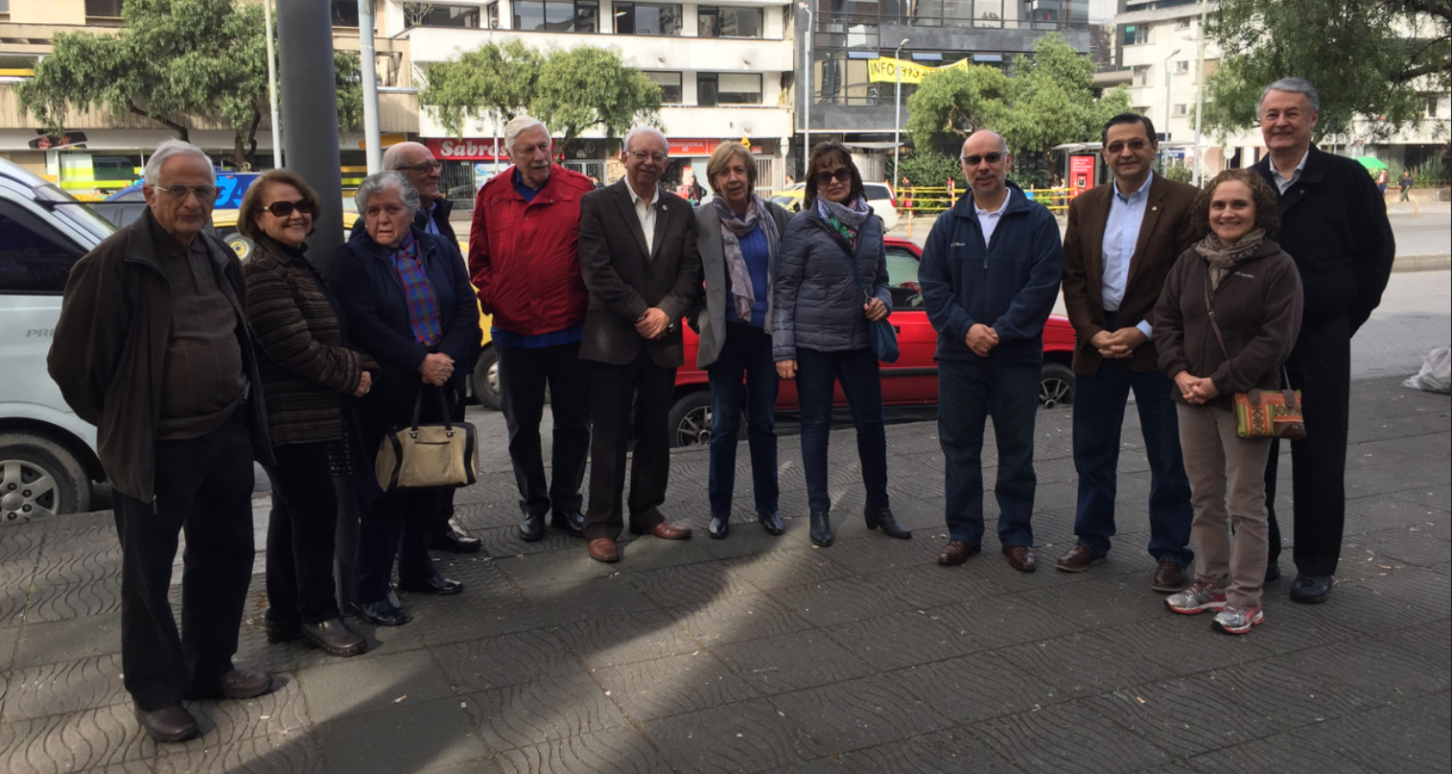
The Team – RC Bogota and BBRC

Slide 4
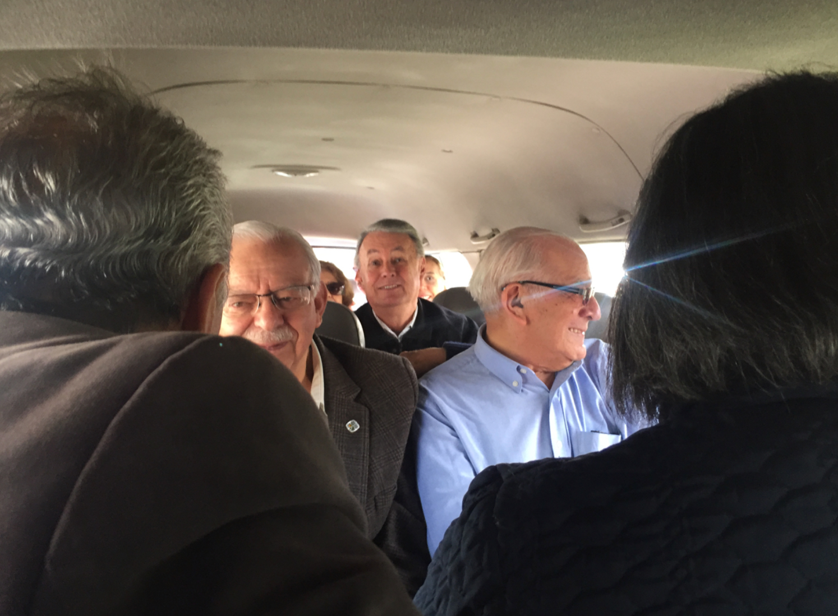
On our way to Ciudad Bolivar

Slide 5
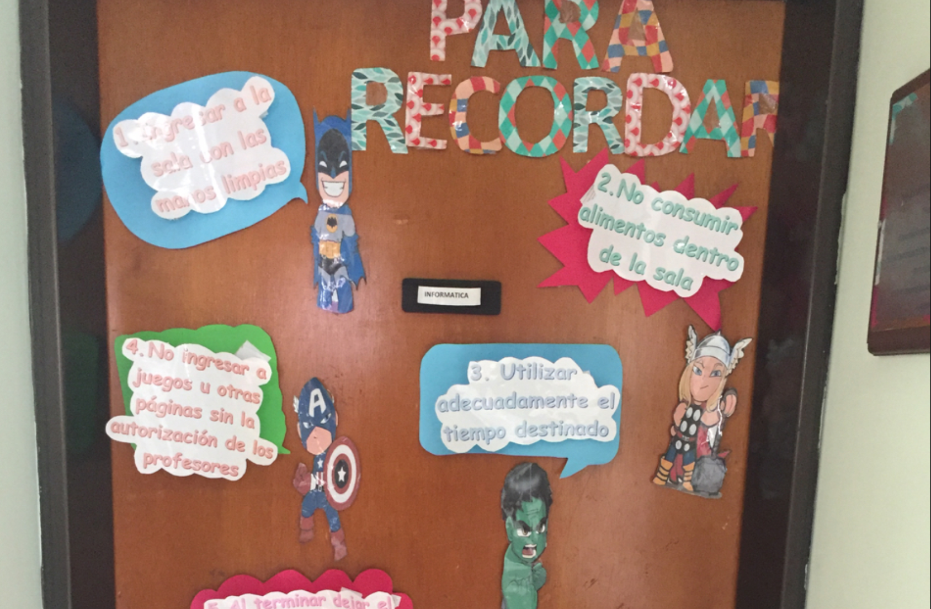
The Computer Room

Slide 6
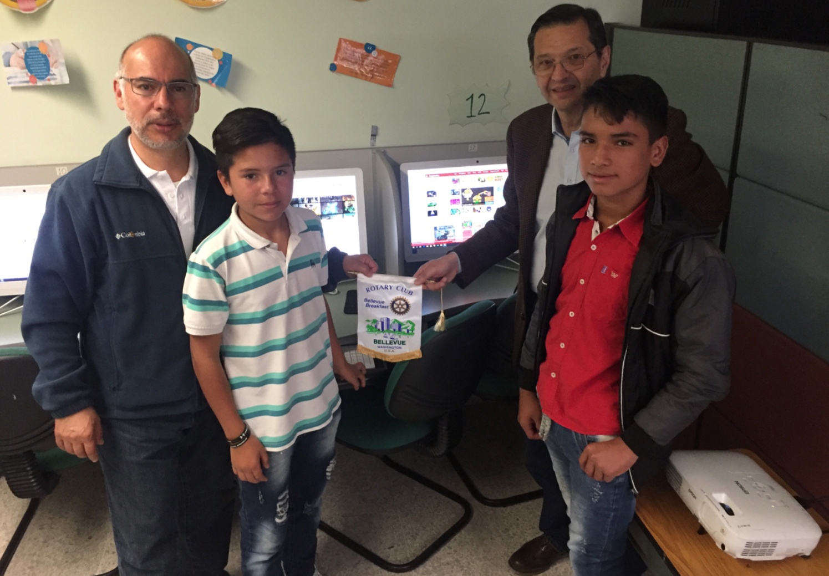
The Rotary Contribution

Slide 7
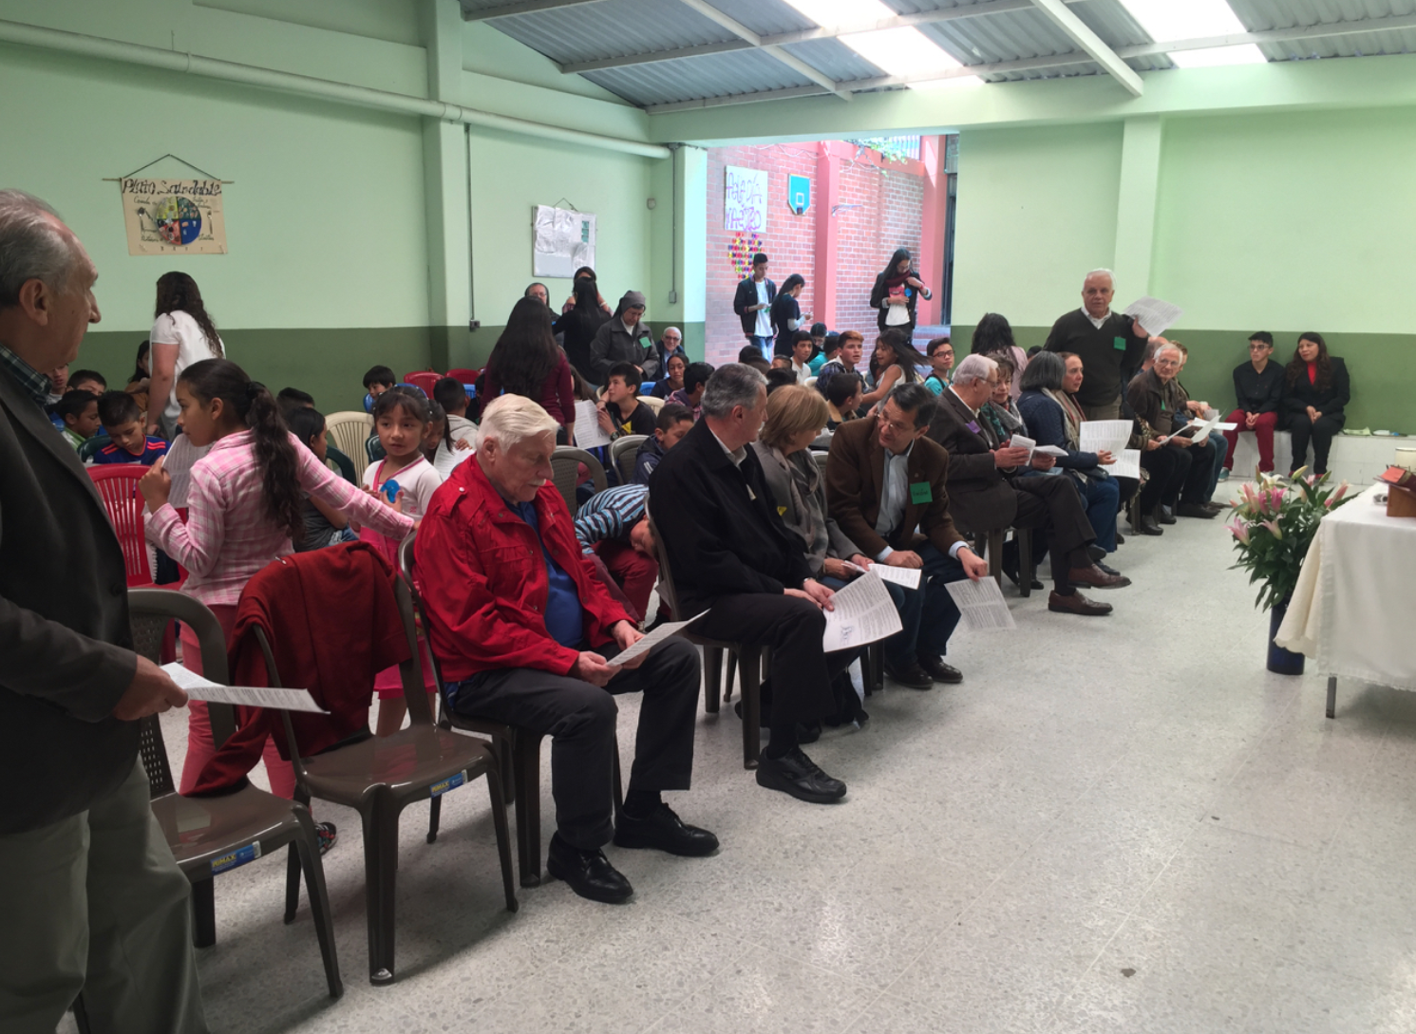
Getting Ready to Celebrate

Slide 8
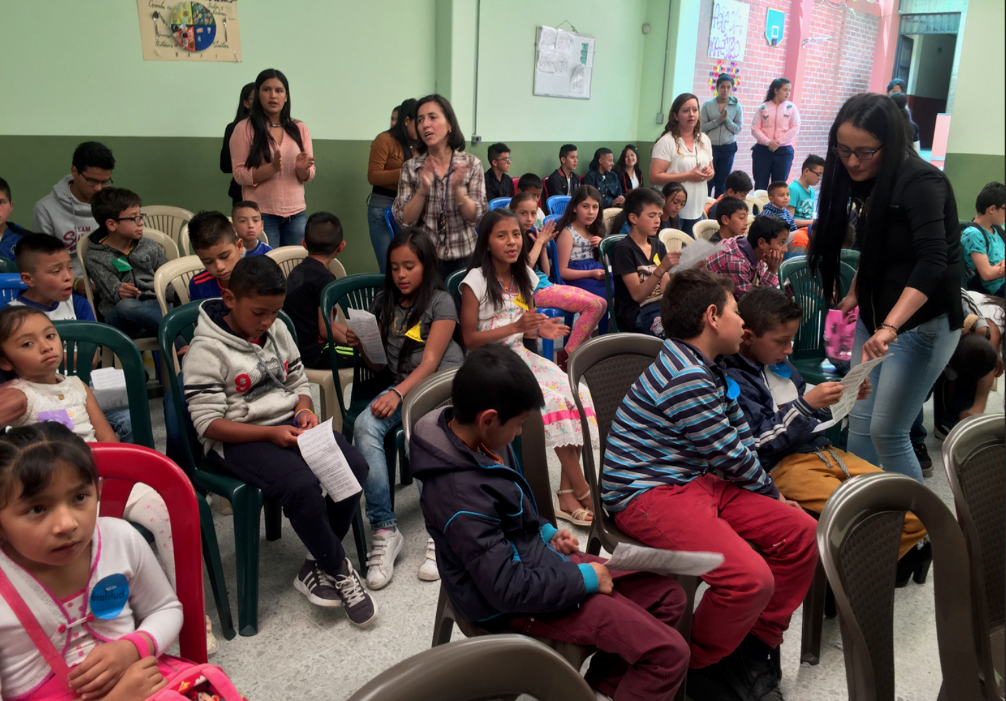
The Beneficiaries

Slide 9
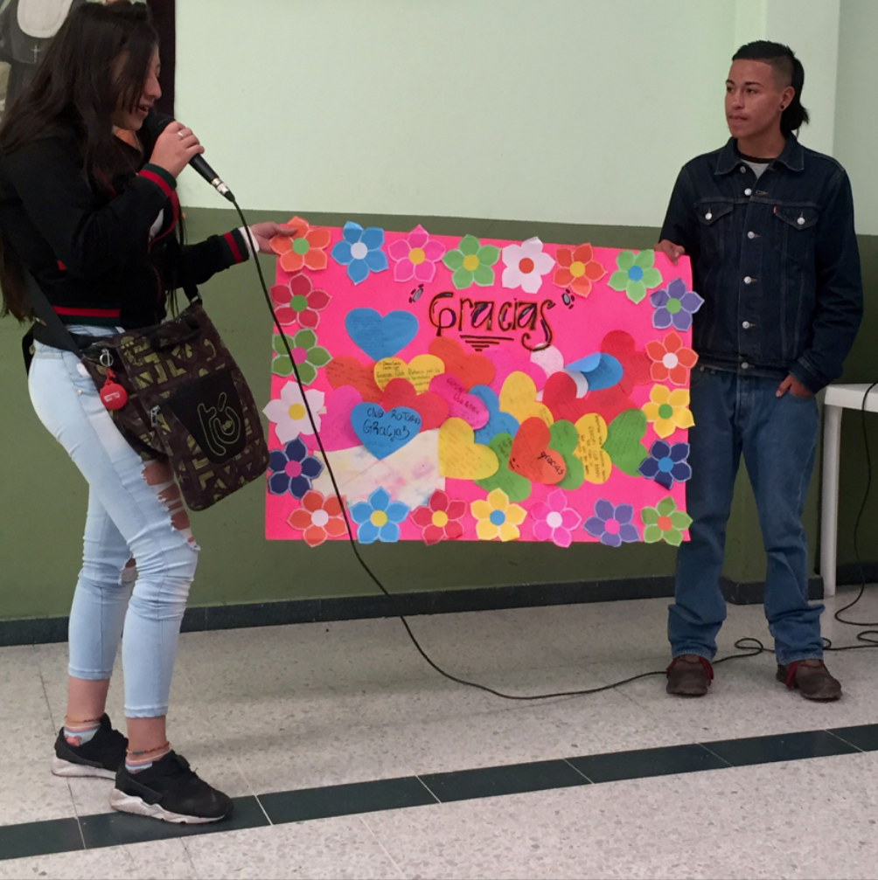
Thank you RC Bogota and BBRC!!!

